Slide 1
Swing
It is a part of Java Foundation Classes (JFC) that is used to create window-based applications.
It is built on the top of AWT (Abstract Windowing Toolkit) API and entirely written in java.
It suitable for developing lightweight desktop applications.
Unlike AWT, Java Swing provides platform-independent and lightweight components.
The javax.swing package provides classes for java swing API such as JButton, JTextField, JTextArea, JRadioButton, JCheckbox, JMenu, JColorChooser etc.

Slide 2
JFC
The Java Foundation Classes (JFC) are a set of GUI components which simplify the development of desktop applications.

Slide 3
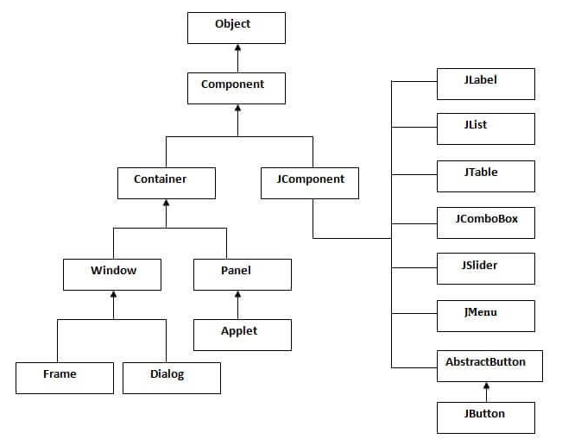
Hierarchy Of Java Swing Classes

Slide 4
Common Methods Of Component Class
Method | Description
public void add(Component c) | add a component on another component.
public void setSize(int width,int height) | sets size of the component.
public void setLayout(LayoutManager m) | sets the layout manager for the component.
public void setVisible(boolean b) | sets the visibility of the component. It is by default false.

Slide 5
Cont…
There are two ways to create a frame:
By creating the object of Frame class (association)
By extending Frame class (inheritance)
We can write the code of swing inside the main(), constructor or any other method.

Slide 6
Simple Java Swing Example
import javax.swing.*;
public class FirstSwingExample {
public static void main(String[] args) {
JFrame f=new JFrame();//creating instance of JFrame
JButton b=new JButton("click");//creating instance of JButton
b.setBounds(130,100,100, 40);//x axis, y axis, width, height
f.add(b);//adding button in JFrame
f.setSize(400,500);//400 width and 500 height
f.setLayout(null);//using no layout managers
f.setVisible(true);//making the frame visible
}
}

Slide 7
Swing by Association inside constructor
import javax.swing.*;
public class Simple {
JFrame f;
Simple(){
f=new JFrame();//creating instance of JFrame
JButton b=new JButton("click");//creating instance of JButton
b.setBounds(130,100,100, 40);
f.add(b);//adding button in JFrame
f.setSize(400,500);//400 width and 500 height
f.setLayout(null);//using no layout managers
f.setVisible(true);//making the frame visible
}
public static void main(String[] args) {
new Simple();
} }

Slide 8
Simple example of Swing by inheritance
import javax.swing.*;
public class Simple2 extends JFrame{//inheriting JFrame
JFrame f;
Simple2(){
JButton b=new JButton("click");//create button
b.setBounds(130,100,100, 40);
add(b);//adding button on frame
setSize(400,500);
setLayout(null);
setVisible(true);
}
public static void main(String[] args) {
new Simple2();
}}

Slide 9
JFrame
The javax.swing.JFrame class is a type of container which inherits the java.awt.Frame class.
JFrame works like the main window where components like labels, buttons, textfields are added to create a GUI.
Unlike Frame, JFrame has the option to hide or close the window with the help of setDefaultCloseOperation(int) method.

Slide 10
Constructors
Constructor | Description
JFrame() | It constructs a new frame that is initially invisible.
JFrame(GraphicsConfiguration gc) | It creates a Frame in the specified GraphicsConfiguration of a screen device and a blank title.
JFrame(String title) | It creates a new, initially invisible Frame with the specified title.
JFrame(String title, GraphicsConfiguration gc) | It creates a JFrame with the specified title and the specified GraphicsConfiguration of a screen device.

Slide 11
Jlabel
The object of JLabel class is a component for placing text in a container.
It is used to display a single line of read only text.
The text can be changed by an application but a user cannot edit it directly.
It inherits JComponent class.

Slide 12
Constructors
Constructor | Description
JLabel() | Creates a JLabel instance with no image and with an empty string for the title.
JLabel(String s) | Creates a JLabel instance with the specified text.
JLabel(Icon i) | Creates a JLabel instance with the specified image.
JLabel(String s, Icon i, int horizontalAlignment) | Creates a JLabel instance with the specified text, image, and horizontal alignment.

Slide 13
Methods
Methods | Description
String getText() | t returns the text string that a label displays.
void setText(String text) | It defines the single line of text this component will display.
void setHorizontalAlignment(int alignment) | It sets the alignment of the label's contents along the X axis.
Icon getIcon() | It returns the graphic image that the label displays.
int getHorizontalAlignment() | It returns the alignment of the label's contents along the X axis.

Slide 14
JButton
The JButton class is used to create a labeled button that has platform independent implementation.
The application result in some action when the button is pushed.
It inherits AbstractButton class.

Slide 15
Constructor
Constructor | Description
JButton() | It creates a button with no text and icon.
JButton(String s) | It creates a button with the specified text.
JButton(Icon i) | It creates a button with the specified icon object.

Slide 16
Methods Of Abstractbutton Class
Methods | Description
void setText(String s) | It is used to set specified text on button
String getText() | It is used to return the text of the button.
void setEnabled(boolean b) | It is used to enable or disable the button.
void setIcon(Icon b) | It is used to set the specified Icon on the button.
Icon getIcon() | It is used to get the Icon of the button.
void setMnemonic(int a) | It is used to set the mnemonic on the button.
void addActionListener(ActionListener a) | It is used to add the action listener to this object.

Slide 17
JTextField
The object of a JTextField class is a text component that allows the editing of a single line text. It inherits JTextComponent class.
Constructor | Description
JTextField() | Creates a new TextField
JTextField(String text) | Creates a new TextField initialized with the specified text.
JTextField(String text, int columns) | Creates a new TextField initialized with the specified text and columns.
JTextField(int columns) | Creates a new empty TextField with the specified number of columns.

Slide 18
Commonly used Methods
Methods | Description
void addActionListener(ActionListener l) | It is used to add the specified action listener to receive action events from this textfield.
Action getAction() | It returns the currently set Action for this ActionEvent source, or null if no Action is set.
void setFont(Font f) | It is used to set the current font.
void removeActionListener(ActionListener l) | It is used to remove the specified action listener so that it no longer receives action events from this textfield.

Slide 19
Java Event Classes And Listener Interfaces
Event Classes | Listener Interfaces
ActionEvent | ActionListener
MouseEvent | MouseListener and MouseMotionListener
MouseWheelEvent | MouseWheelListener
KeyEvent | KeyListener
ItemEvent | ItemListener
TextEvent | TextListener
AdjustmentEvent | AdjustmentListener
WindowEvent | WindowListener
ComponentEvent | ComponentListener
ContainerEvent | ContainerListener
FocusEvent | FocusListener

Slide 20
Java Event Handling Code
We can put the event handling code into one of the following places:
Within class
Other class
Anonymous class
Java event handling by implementing ActionListener
Java event handling by outer class
Java event handling by anonymous class

Slide 21
2D Shape
“Graphics,” class that will allow us to call basic 2D shapes that can be drawn to a window.
The “JFrame,” class that allows for us to create a regular window to draw our shapes to the screen.
The “Canvas,” extension which allows for us to use the paint function to make it easier to draw the shapes to the screen.
Graphics object manages graphics context .Controls how information is drawn.
Class Graphics is abtract
Cannot be instantiated
Contributes to Java's portability

Slide 22
Contd…
Class JComponent contains method paintComponent, which is used to draw graphics on a component.
Class Component method paint takes Graphics object
public void paint (Graphics g)
Called through method repaint
Class Color
Defines methods and constants for manipulating colors
Colors are created from red, green and blue components
RGB values

Slide 23
Graphics context
-Enables drawing on screen
-Graphics object manages graphics context .Controls how information is drawn
-Class Graphics is abtract
.Cannot be instantiated
.Contributes to Java's portability
-Class Component method paint takes Graphics object
public void paint (Graphics g)
-Called through method repaint
Class Color
-Defines methods and constants for manipulating colors
-Colors are created from red, green and blue components
.RGB values

Slide 24
Java Adapter Classes
Java adapter classes provide the default implementation of listener interfaces
. If you inherit the adapter class, you will not be forced to provide the implementation of all the methods of listener interfaces. So it saves code.
The adapter classes are found in java.awt.event, java.awt.dnd and javax.swing.event packages

Slide 25
Pros Of Using Adapter Classes
It assists the unrelated classes to work combinely.
It provides ways to use classes in different ways.
It increases the transparency of classes.
It provides a way to include related patterns in the class.
It provides a pluggable kit for developing an application.
It increases the reusability of the class.

Slide 26
Adapter Classes With Their Corresponding Listener Interfaces
java.awt.event Adapter classes
Adapter class | Listener interface
WindowAdapter | WindowListener
KeyAdapter | KeyListener
MouseAdapter | MouseListener
MouseMotionAdapter | MouseMotionListener
FocusAdapter | FocusListener
ComponentAdapter | ComponentListener
ContainerAdapter | ContainerListener
HierarchyBoundsAdapter | HierarchyBoundsListener

Slide 27
java.awt.dnd Adapter classes
Adapter class | Listener interface
DragSourceAdapter | DragSourceListener
DragTargetAdapter | DragTargetListener
javax.swing.event Adapter classes
Adapter class | Listener interface
MouseInputAdapter | MouseInputListener
InternalFrameAdapter | InternalFrameListener

Slide 28
import java.awt.*;
import java.awt.event.*;
public class AdapterExample {
Frame f;
AdapterExample() {
f = new Frame ("Window Adapter");
f.addWindowListener (new WindowAdapter() {
public void windowClosing (WindowEvent e) {
f.dispose();
}
});
f.setSize (400, 400);
f.setLayout (null);
f.setVisible (true);
}
public static void main(String[] args) {
new AdapterExample();
}
}

Slide 29
import java.awt.*;
import java.awt.event.*;
public class MouseAdapterExample extends MouseAdapter {
Frame f;
MouseAdapterExample() {
f = new Frame ("Mouse Adapter");
f.addMouseListener(this);
f.setSize (300, 300);
f.setLayout (null);
f.setVisible (true);
}
public void mouseClicked (MouseEvent e) {
Graphics g = f.getGraphics();
g.setColor (Color.BLUE);
g.fillOval (e.getX(), e.getY(), 30, 30);
}
public static void main(String[] args) {
new MouseAdapterExample();
}
}

Slide 30
MVC Architecture
The Model-View-Controller (MVC) is a well-known design pattern in the web development field.
It specifies that a program or application shall consist of data model, presentation information and control information.
The MVC pattern needs all these components to be separated as different objects.
Model: It represents the business layer of application. It is an object to carry the data that can also contain the logic to update controller if data is changed.
View: It represents the presentation layer of application. It is used to visualize the data that the model contains.
Controller: It works on both the model and view. It is used to manage the flow of application, i.e. data flow in the model object and to update the view whenever data is changed.

Slide 31
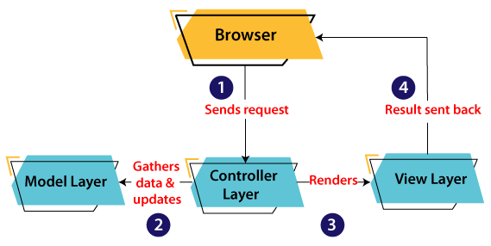

Slide 32
Contd…
A client (browser) sends a request to the controller on the server side, for a page.
The controller then calls the model. It gathers the requested data.
Then the controller transfers the data retrieved to the view layer.
Now the result is sent back to the browser (client) by the view.

Slide 33
Advantages Of MVC Architecture
MVC has the feature of scalability that in turn helps the growth of application.
The components are easy to maintain because there is less dependency.
A model can be reused by multiple views that provides reusability of code.
The developers can work with the three layers (Model, View, and Controller) simultaneously.
Using MVC, the application becomes more understandable.
Using MVC, each layer is maintained separately therefore we do not require to deal with massive code.
The extending and testing of application is easier.

